Slide 1
GNNs for designing organic materials
26/02/04
Dr Sam A. J. Hillman
AI in Science Schmidt Fellow, Department of Chemistry

Slide 2
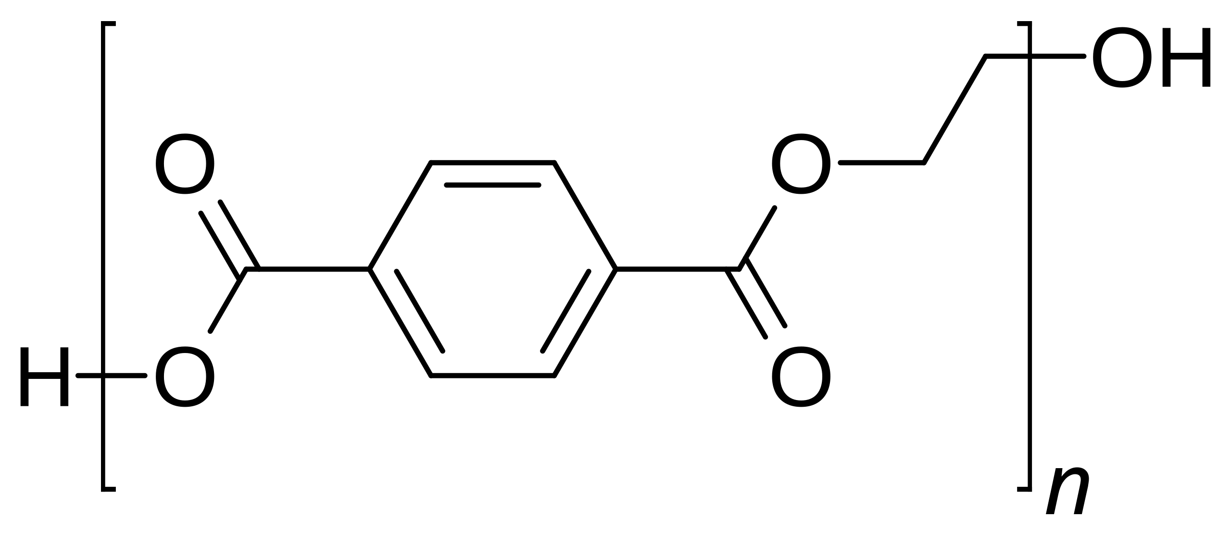
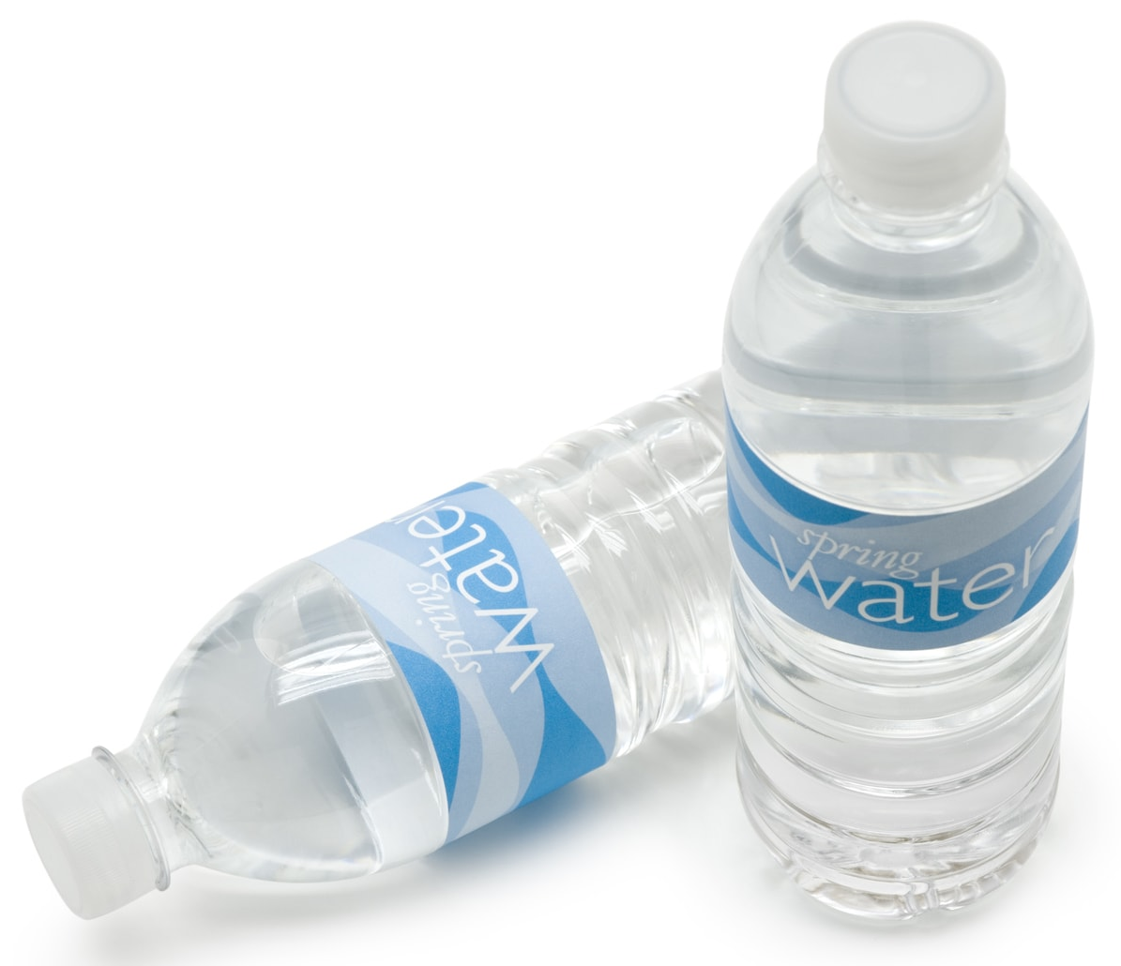
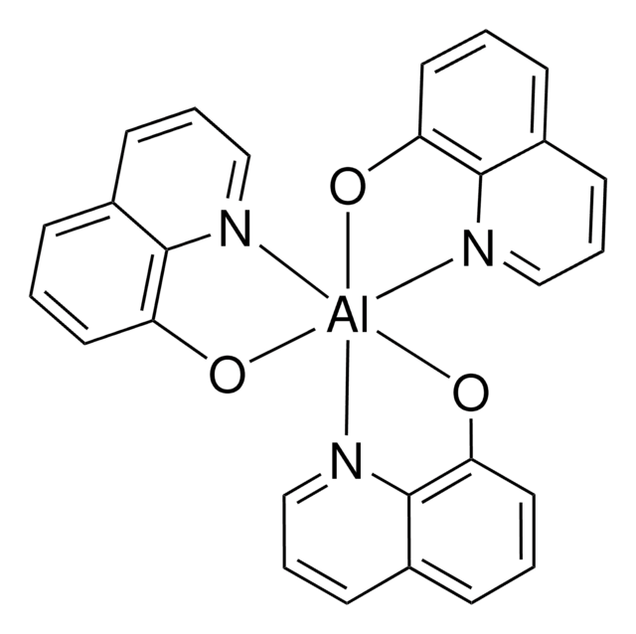

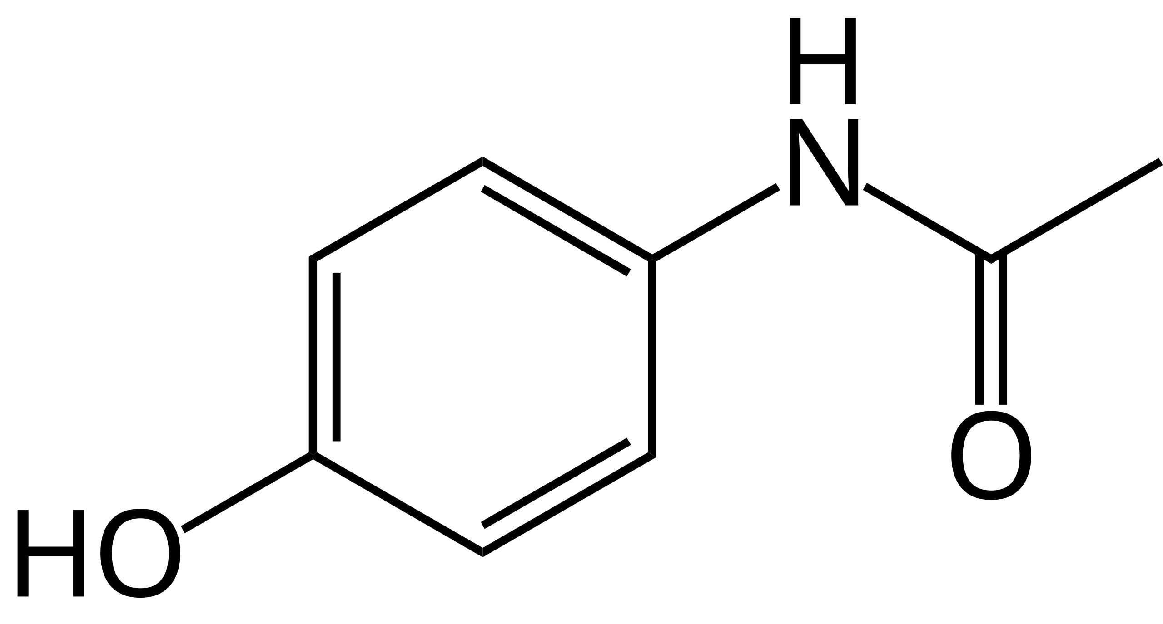
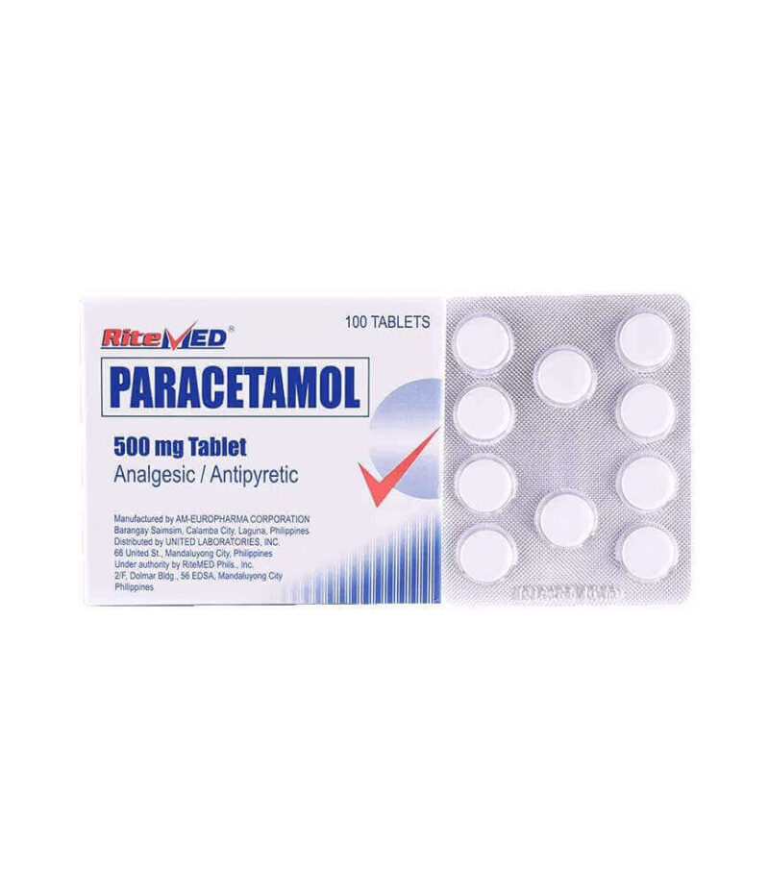
Why do we want new organic materials?
Organic = carbon-based
Notes:
There are lots of benefits to organics – soft, light, transparent, chemically resistant, can be highly bioavailable – or not!

Slide 3
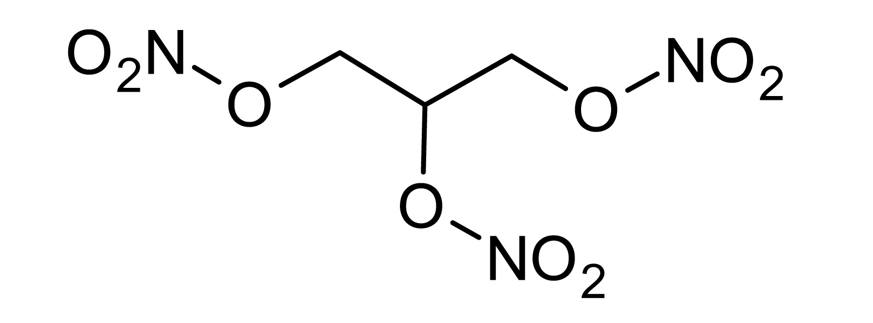
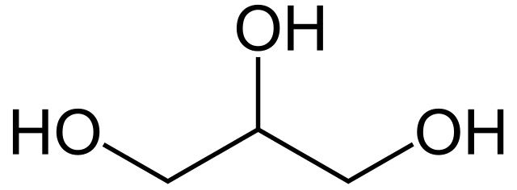
Benefits of organics
Tuneable synthetic control of key properties
Glycerol
= food
Nitroglycerol
= explosives

Slide 4
What do we want?
desired property
→
candidate structures
Massive chemical search space!
Materials synthesis and characterisation is extremely slow and requires an expert
Notes:
Multiple properties e.g. efficacy, but also non-toxicity.

Slide 5
What do we want?
desired property
→
candidate structures
Massive chemical search space!
Materials synthesis and characterisation is extremely slow and requires an expert
Easier! You also may be constrained by the chemical space you can access.
candidate structures
→
desired property
Notes:
Much easier to go from candidate → property (predictive vs generative).

Slide 6
Problem: solar-driven catalysis of water

Slide 7
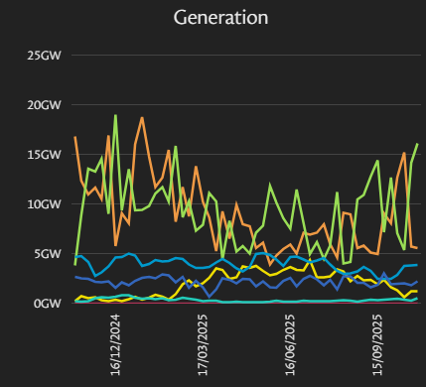
Problem: solar-driven catalysis of water
Solar energy
Solar energy provides 6% of UK annual demand
Twice as much sun annually in South Africa!
But we need seasonal energy storage
2025
solar
https://grid.iamkate.com/
Notes:
Solar energy generation has doubled since 2016 in the UK

Slide 8

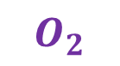
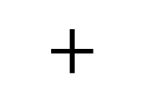
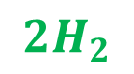
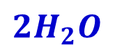
Problem: solar-driven catalysis of water
Solution: Use sunlight to extract hydrogen from water
$${2H}_{2}O$$
$${2H}_{2}$$
$$+$$
$$O_{2}$$
water
hydrogen
oxygen

Slide 9
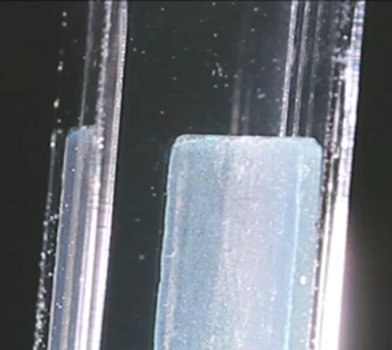
Problem: solar-driven catalysis of water
Solution: Use sunlight to extract hydrogen from water
Use photocatalysts to overcome energy barrier
$${2H}_{2}O$$
catalyst
$${2H}_{2}$$
$$+$$
$$O_{2}$$
water
hydrogen
oxygen
Notes:
High interest in using polymers for this because its so easy to tune the properties

Slide 10
Problem: Why polymers?
What's a polymer?
Sprick et al, JACS 2015, 137, 9, 3265

Slide 11
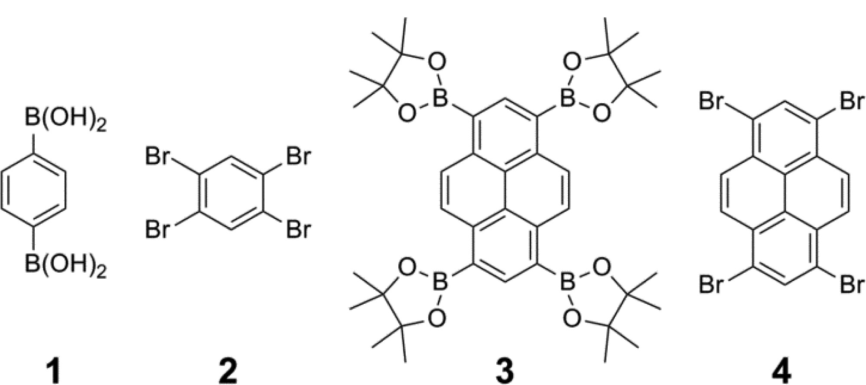
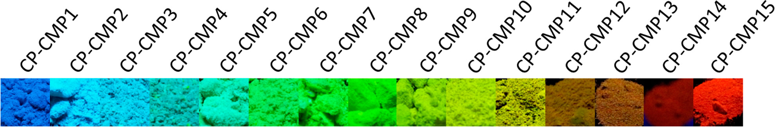
Problem: Why polymers?
Combine monomers to make polymers with tuneable properties
Sprick et al, JACS 2015, 137, 9, 3265

Slide 12
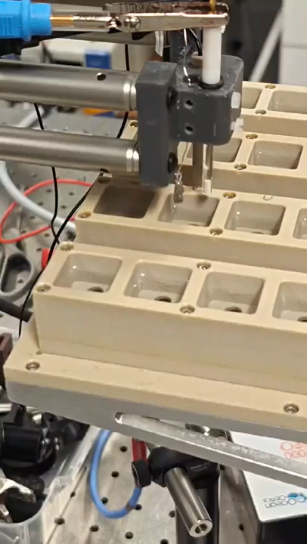
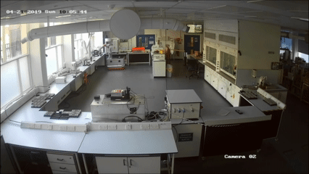
Problem: Why polymers?
Combine monomers to make polymers with tuneable properties
Amenable to automated synthesis
Bai et al, JACS, 2019, 141, 22, 9063; Burger et al, Nature, 2020, 583, 237

Slide 13
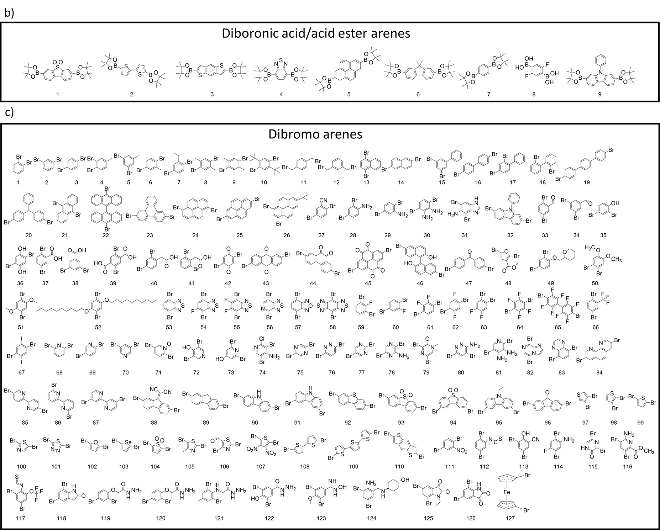
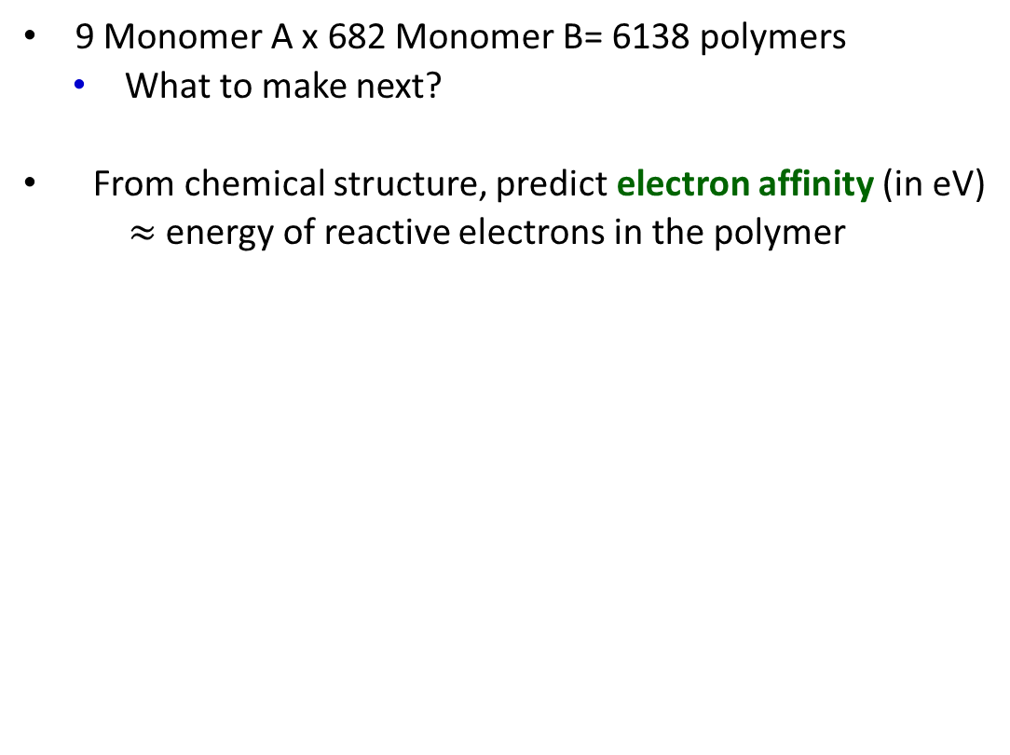
Problem
9 Monomer A x 682 Monomer B= 6138 polymers
What to make next?
From chemical structure, predict electron affinity (in eV)
$≈$ energy of reactive electrons in the polymer
Monomer A
Monomer B
Bai et al, JACS, 2019, 141, 22, 9063
Notes:
EA can be calculated from density functional theory.

Slide 14
Problem
How do we get our candidate structures in the first place?
candidate structures
→
desired property

Slide 15
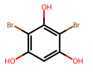
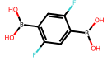
SMILES
All molecules have SMILES ☺
Simplified Molecular Input Line Entry System
Every molecule can be written in SMILES notation
Oc1cc(O)c(Br)c(O)c1Br
OB(O)c1cc(F)c(B(O)O)cc1F

Slide 16
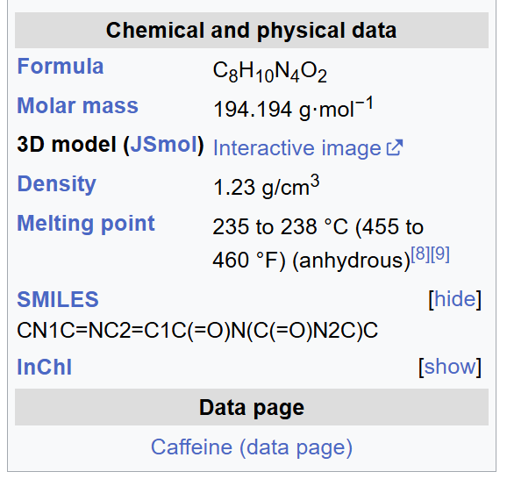
SMILES
All molecules have SMILES ☺
Simplified Molecular Input Line Entry System
Every molecule can be written in SMILES notation
Easy to find
Oc1cc(O)c(Br)c(O)c1Br
OB(O)c1cc(F)c(B(O)O)cc1F
Notes:
SMILES easy to find in database (Wikipedia!), uniquely identifying.

Slide 17
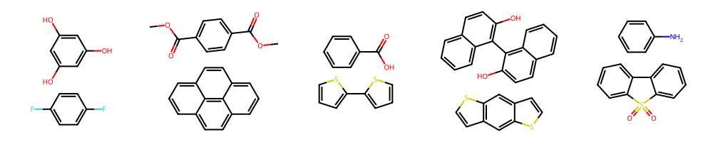
SMILES → graphs
Make graphs from SMILES (e.g. RDKit)
These permutation invariant graphs have nodes (atoms) and edges (bonds)
Can do digital chemistry e.g. make polymers!
Oc1cc(O)c(Br)c(O)c1Br
OB(O)c1cc(F)c(B(O)O)cc1F
Oc1cc(O)cc(O)c1. Fc1ccc(F)cc1
Notes:
SMILES to graph → tokenisation to identify atoms (e.g. O) vs bonds (e.g. =) vs others (e.g. brackets). Chemical properties for nodes and edges are then calculated and stored.
re-ordering (re-labelling) the nodes (atoms) should give the same result
https://dmol.pub/dl/gnn.html

Slide 18
Problem
candidate structures
desired property

Slide 19
Problem
Structures sorted! But how do we get from structure to properties?
SMILES
RDKit
candidate structures
desired property

Slide 20
Problem
How do we get our structures into the predictor head?
SMILES
RDKit
candidate structures
predictor head
desired property

Slide 21
Representations
Representations = vector embeddings that capture the chemistry of our materials
SMILES
RDKit
Representations
candidate structures
predictor head
desired property
Notes:
We need representations: ways of digitally representing molecule structures in a ML-friendly way.

Slide 22
Representations
SMILES
RDKit
Representations
Fixed
Learned
candidate structures
predictor head
desired property

Slide 23
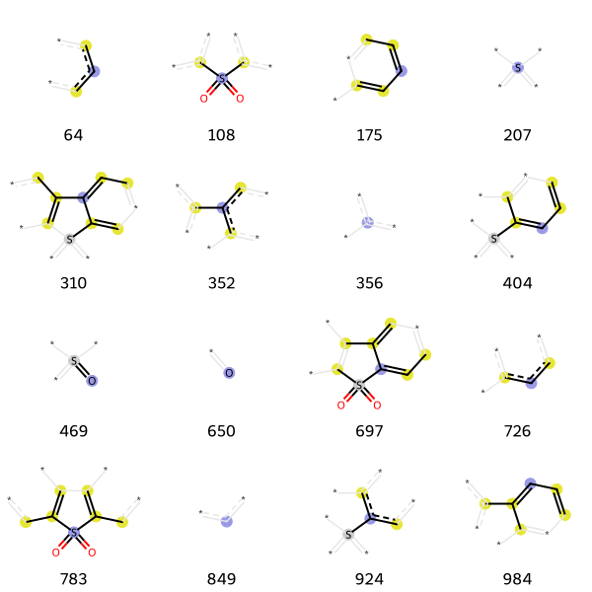

Fixed representations
Deterministic method for calculating vector embeddings for our materials
We will use “Morgan fingerprints” to build local environments = chemistry
radius=0
r=1
r=2
Notes:
Each substructure gets an ID. IDs are calculated by hashing the IDs of all neighbouring atoms.
Duplicate IDs are counted.
Hash into a vector.

Slide 24
Fixed representations
First notebook
https://github.com/S-AJ-H/AIMS26

Slide 25
Learned representations
Deterministic descriptors of molecules are great!
But we could use a neural network to learn hidden features directly from the data…
SMILES
RDKit
Representations
Learned via NN
candidate structures
predictor head
desired property

Slide 26
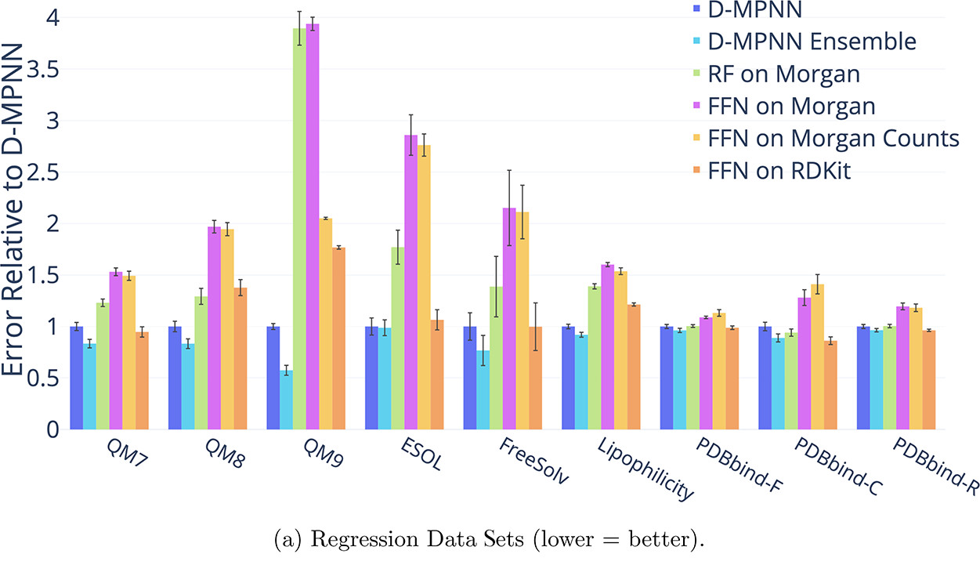
Learned representations
Deterministic descriptors of molecules are great!
But we could use a neural network to learn hidden features directly from the data…
Graph neural networks:
Flexible – representation specific to problem
Break away from human intuition/knowledge
Yang et al, J. Chem. Inf. Model. 2019, 59, 8, 3370–3388

Slide 27
Learned representations
We learn hidden representations of materials through message passing and aggregation
1. Message passing
2. aggregation
candidate structures
hidden
atom representations
hidden
molecule representations
predictor head

Slide 28
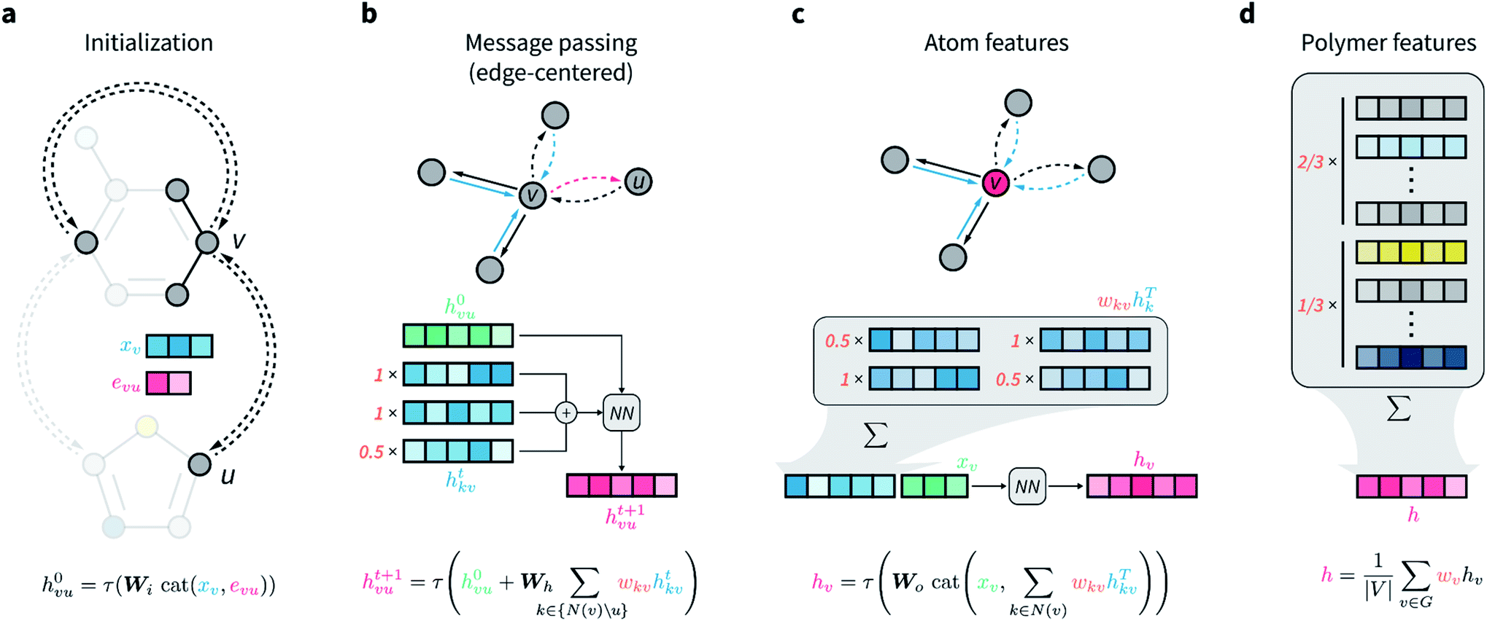
Message passing
Initialisation
Get initial the atom (x_{v}) and bond (e_{vu}) features generated from RDKit (charge, mass etc)

Slide 29
Message passing
Initialisation
Get initial the atom (x_{v}) and bond (e_{vu}) features generated from RDKit (charge, mass etc)
Concatenate, pass through a simple neural network → get initial hidden bond features h_{vu}(steps=0)

Slide 30
Message passing
Get initial the atom (x_{v}) and bond (e_{vu}) features generated from RDKit (charge, mass etc)
Concatenate, pass through a simple neural network → get initial hidden bond features h_{vu}(steps=0)
For each (directional) bond vu, sum the hidden features of all neighbouring bonds connected to atom v

Slide 31
Message passing
Get initial the atom (x_{v}) and bond (e_{vu}) features generated from RDKit (charge, mass etc)
Concatenate, pass through a simple neural network → get initial hidden bond features h_{vu}(steps=0)
For each (directional) bond vu, sum the hidden features of all neighbouring bonds connected to atom v
pass through a simple neural network → new hidden bond features h_{vu}(1)

Slide 32
Message passing
Get initial the atom (x_{v}) and bond (e_{vu}) features generated from RDKit (charge, mass etc)
Concatenate, pass through a simple neural network → get initial hidden bond features h_{vu}(steps=0)
For each (directional) bond vu, sum the hidden features of all neighbouring bonds connected to atom v
pass through a simple neural network → new hidden bond features h_{vu}(1)
3. Iterate for some number of steps T: With more steps, each bond learns more about its local environment.

Slide 33
Message passing
Get initial the atom (x_{v}) and bond (e_{vu}) features generated from RDKit (charge, mass etc)
Concatenate, pass through a simple neural network → get initial hidden bond features h_{vu}(steps=0)
For each (directional) bond vu, sum the hidden features of all neighbouring bonds connected to atom v
pass through a simple neural network → new hidden bond features h_{vu}(1)
3. Iterate for some number of steps T: With more steps, each bond learns more about its local environment.

Slide 34
Aggregation
Sum all incoming bonds h_{kv}^{T} to atom v
pass through a simple neural network → atom representations h_{v}
Sum h_{v} → molecule representation h
Input into predictor head with target properties!
3 set of MPNN weights + predictor weights are trained end to end
Invariant to atom and bond indexes
Notes:
Aggregate atoms as don’t have to worry about double counting and bond directionality.

Slide 35
Learned representations
Notebooks 2 and 3
Using Chemprop (built on PyTorch)
https://github.com/S-AJ-H/AIMS26

Slide 36
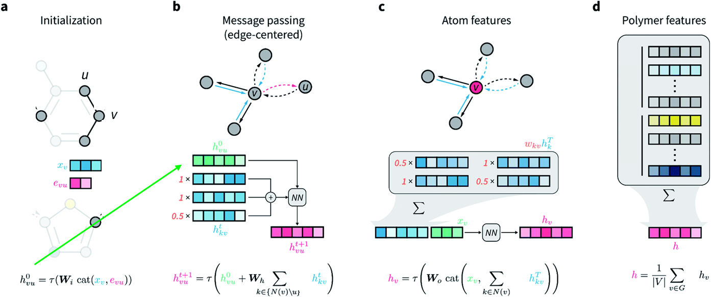
Chemprop: message passing NN
Coley et al, Chem. Sci., 2022, 13, 10486
Notes:
https://pubs.acs.org/doi/10.1021/acs.jcim.3c01250 explains best
https://pubs.acs.org/doi/10.1021/acs.jcim.9b00237
https://pubs.rsc.org/en/content/articlelanding/2022/SC/D2SC02839E

Slide 37
Summary
Property prediction in organic chemistry is all about how you represent your materials
Graphs and molecules are alike – algorithms can build local environments
Fixed descriptors
Deep learning with MPNNs
Pros of MPNNs:
State of the art performance, particularly for polymers
Non-intuitive chemical discovery
No bias towards choice of descriptors
Cons of MPNNs:
Larger datasets required
Can be computationally expensive
Low interpretability
Notes:
Data-efficient relative to language-based models

Slide 38
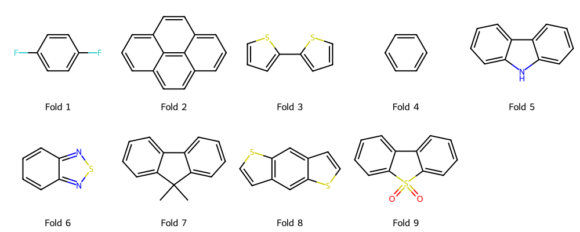
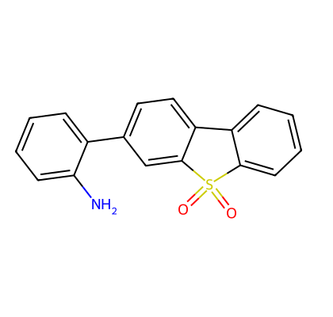
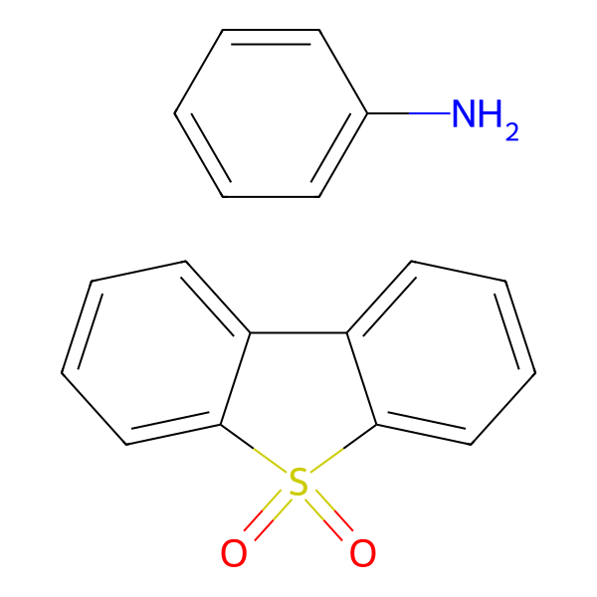
Projects
Structure splitting
How well can our model predict new
molecules?
Better(?) polymer representations
How does including more explicit bonding impact these models?

Slide 40
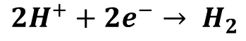
Key properties for polymer photocatalysts
Two of the most important characteristics of a polymer are its Electron Affinity and Ionisation Potential
These energetic levels define:
the energetic driving forces for hydrogen evolution
The polymers’ absorption properties (Eg = EA-IP)
Can be calculated
Energy
sunlight
EA
Eg
$$2H^{+}+2e^{−}→ H_{2}$$
IP

Slide 41
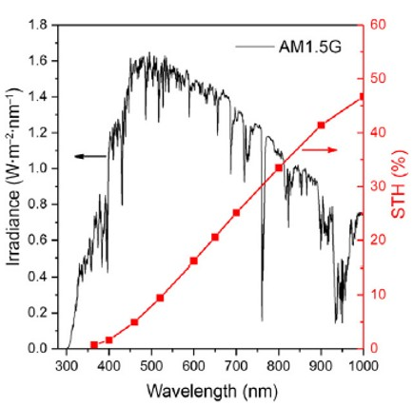
Why use polymers?
Inorganics:
Poor solar absorption
Hard to tune properties
High processing costs
Unsustainable elements
Domen et al, Trends Chem 2020, 2, 813–824
Notes:
> 850 citations (2024)

